Slide 1
Mahdi Kashani
Atreya Bain
HPCC SQL (HSQL)
Notes:
Hello everyone and welcome our HSQL demo session.
My name is Mahdi Kashani, and I am a Software Eng @ LexisNexis Risk, and I will be co-presenting with Atreya Bain, a brilliant intern from RVCE College of Engineering in India.
2 second pause
.

Slide 2
Agenda
Introduction
Objectives
What’s new
SELECT
Visualization tie-in
Modularity and Functions
Creating and using Machine Learning models
Notes:
In the first part of this demo, we will introduce the HSQL Language, why it is needed in our today’s tech industry, the latest and greatest features available for customer use, and then we will present on the how to install and start with the HSQL language, Select command as one of the basic statements, visualization library that is used with HSQL, the modularity feature in this language and how to train and use Machine Learning models with it.
2 second pause
.
.

Slide 3
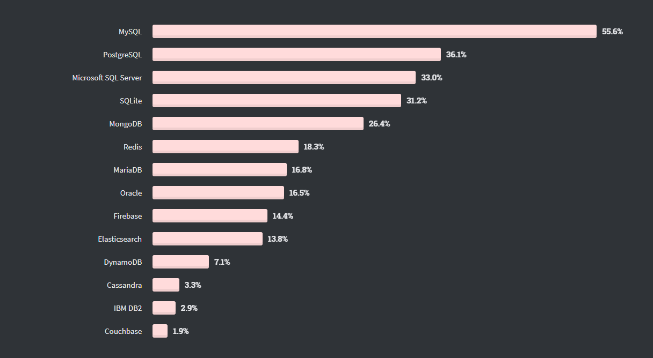
Why an SQL-like language?
SQL has been around for years.
Support relational databases.
Why not leverage this popularity as a way of entry into HPCC Systems?
Most Voted for Database Technologies
2020 Stack Overflow Survey
Notes:
SQL was first developed in 1974, and since then it has been very popular between data-base developers, especially when it comes to working with relational data-bases!! As a reference, if we look at 2020 “StackOverFlow” survey on most used data bases we will see that the top 4 choices are SQL-Based.
Given its extensive usage by developers , we decided to develop HSQL (that stands for) HPCC systems supported SQL.
It is designed mostly for SQL developers that are interested to develop on HPCC systems platform.
With HSQL, developers can easily adopt to the HPCC systems platform and start working with big-data right away.
2 second pause
.
.

Slide 4
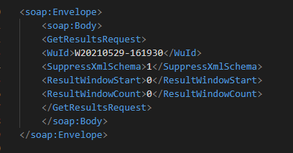
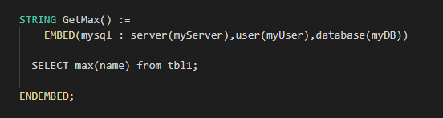
SQL & HPCC
SQL EMBED
ECL inline, SQL support
WsSQL
SQL interface to HPCC
Notes:
Currently SQL is being supported by HPCC systems is two ways:
First is our SQL EMBED structure. Which developers can write SQL code directly in ECL . While the pro of this feature is the capability of coding in SQL, the con is that developer needs to know some ECL and how to wrap the SQL EMBED with ECL.
[ mouse click ]
Second support system is:: WsSQL :: which is a service that provides a SQL interface into HPCC Systems. This web service accepts a subset of prepared and standard SQL queries, while it gives you access to HPCC systems data.
One of the drawbacks of this features is all your SQL queries are submitted via SoapCall (API call), and user have limited options when it comes to Data Analytics and Machine Learning.
2 second pause
.
.

Slide 5
HSQL Capabilities
Interface for data science
Data lake Support
Data Visualization platform
Supports Machine Learning
Notes:
HSQL essentially aims to be a seamless interface for data science developers to use and it helps you to explore the data in the HPCC system data lake.
HSQL is a great language since it can support data visualization and machine learning algorithms for our data analysts as well.
//#% - It can also work smoothly alongside ECL which makes it easy to integrate with the new and existing programs.
HSQL translates to ECL, and it is beneficial to new users, because they don’t need to worry about learning ECL or integrating other tools such as visualization tools with it.
2 second pause
.

Slide 6
A layered solution
Data Consumers
Tombolo – Data Catalog | ECL Watch (Admin Interface)
ECL IDEs (Web or Client) | Dashboard and IoT Hub
Connectivity and 3rd-Party Solutions
Spark
HDFS
ODBC/JDBC
Apache Kafka
MySQL Connectivity
SQL Query Interface
Java API
Elastic Search
Analytics Libraries
Data Management: | Normalization | Batch Services | Profiling | Cleaning
Machine Learning: | Distributed Parallel Machine Learning Library
Common Language
ECL | HPCC SQL (HSQL)
Data Engines
Thor Cluster | ROXIE Cluster
Notes:
Speaking of where HSQL fits into the whole idea of HPCC systems, HSQL is essentially designed to complements ECL and is more Intended toward simple data ingestion, exploration and simple machine learning applications. %It should work smoothly alongside ECL and easily integrate with the new and existing ECL codes/programs.
2 second pause
.

Slide 7
What’s new
An intermediate stage during compilation
Separate syntax checking and code generation into two separate phases
Functions
Writing reusable code
Modules
Bundle up code to give it a better structure
Everything else
Additional features for most statements
HSQL
Lexical Analysis
Code Generation
Syntactic Analysis
Semantic Analysis
ECL
Notes:
So, talking about what we have added to HSQL, we have added a new intermediate stage to separate syntax checking and code generation into two separate phases. This is very helpful when it comes to IDE support and fast syntax checks.
Also, from the Language side we have added functions which help you write reusable code & modules which give your code an organized structure. There are other statements in this language which have had new features added to them to make them easier and better to use. For example the right statement and create (layout) statement have been introduced and the select statement has had new clauses added to it to make HSQL easier and better to use.
2 sec pause
.

Slide 8
Demo Atreya Bain
Notes:
Now, please let me invite to Atreya to demo HSQL! Atreya, the floor is yours.
…
Thank you for the great introduction, Mahdi. Hi, I’m Atreya, and I’ll be here to show off some of the things that you can do with HSQL!
2 second pause
.

Slide 9
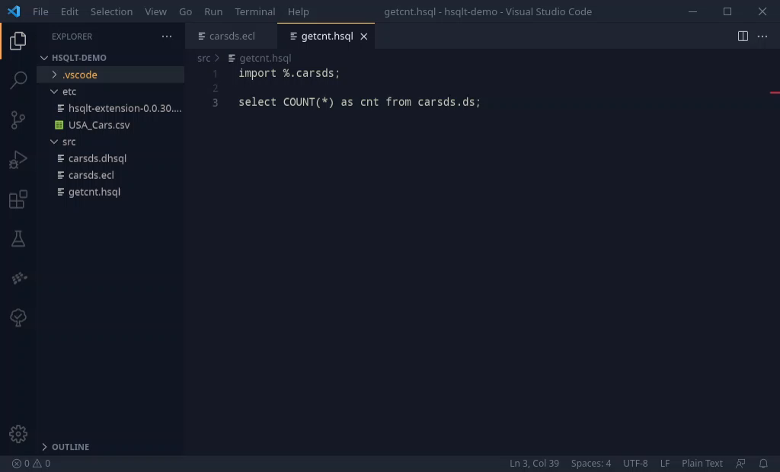
Using HSQL
Packaged up as a simple extension
Syntax Checking
Autocompletion Options
ECL conversions
Notes:
Here, I’m showing a window from VSCode, it’s a great IDE and I have already have an HSQL files open, getcnt. It is currently showing a simple import from a module, and a select query. You can see some of the samples already in the source directory, and the etc directory has the dataset we’re going to be working with, a simple dataset of cars, and the HSQL extension.
To get started with HSQL, we can use the extension and its super easy to install. <click for anim> You can just right click on it, and that opens a context menu, and then we can click on install and its ready!
You can already see that the extension adds syntax highlighting.
2 second pause

Slide 10
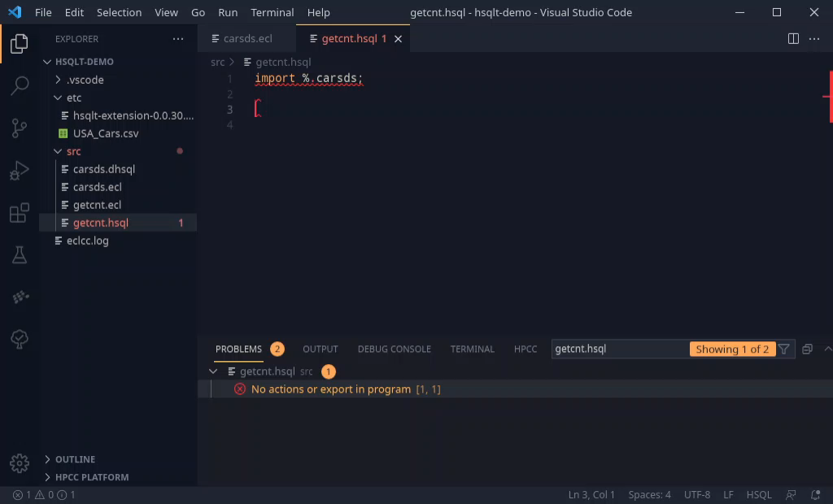
Using HSQL
Packaged up as a simple extension
Syntax Checking
Autocompletion Options
ECL conversions
Notes:
After installing the extension we can see that the extension performs syntax checking and shows any errors in the program. The extension is currently saying that there are no actions in the current program, and we can fix this error here by adding our first query, <click for anim>, a select query, and you can see that with the help of autocomplete options I can quickly write out the statement.
This is a simple query to give a count of the number of rows in our cars dataset

Slide 11
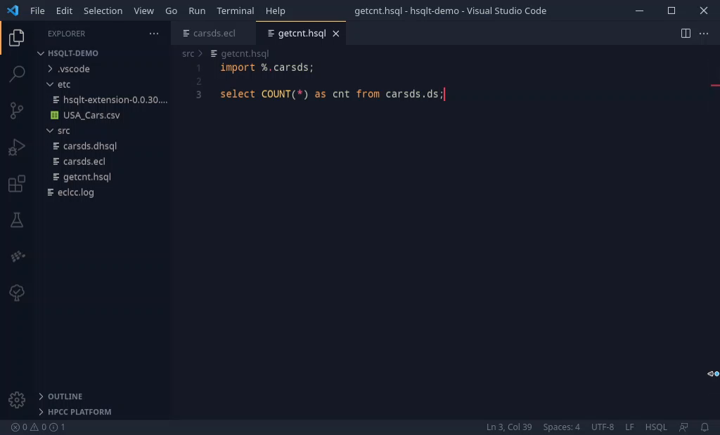
Using HSQL
Packaged up as a simple extension
Syntax Checking
Autocompletion Options
ECL conversions
Notes:
Once the code has been written out, the extension can also be used to convert your HSQL code into ECL for execution. We can open up the command palette on VSCode <click for anim> by pressing CTL+Shift+P, and then select the command for translation. You can now see on the left the ECL code has been created.
2 second pause

Slide 12
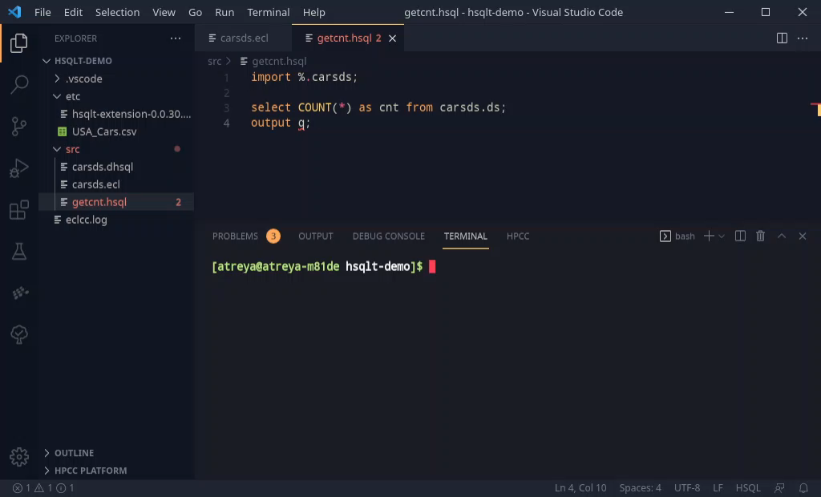
Using HSQL
Also available as a CLI tool
Syntax Checking
ECL conversions
Running Workunits
Notes:
If you are not using VSCode or have other workflows, There is also a CLI tool available for use, <click for anim> which you can use for syntax checking and translation.
Here I have deliberately inserted an invalid statement, and we can see that the tool will report any errors or warnings from compiling your program.
2 second pause

Slide 13
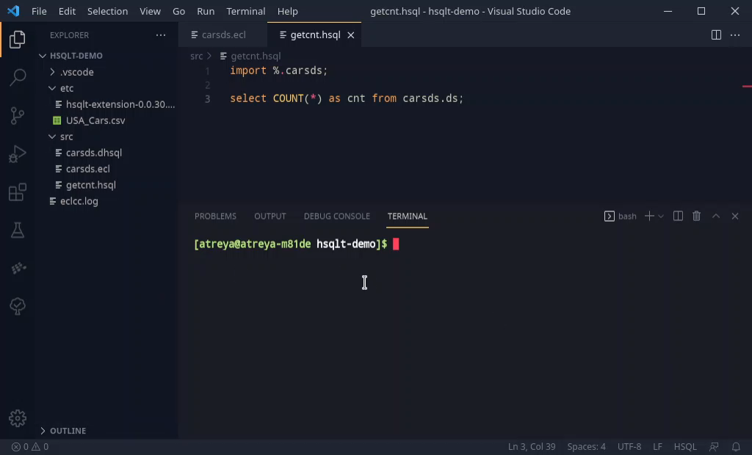
Using HSQL
Also available as a CLI tool
Syntax Checking
ECL conversions
Submit Workunits
Notes:
Additionally, once your code is ready, the CLI tool can also be used to submit <click for anim> HSQL programs to a cluster after translation, using ECL Client tools in the background.
We see that the dataset that we have contains 2499 elements, with the help of this simple query.
2 second pause

Slide 14
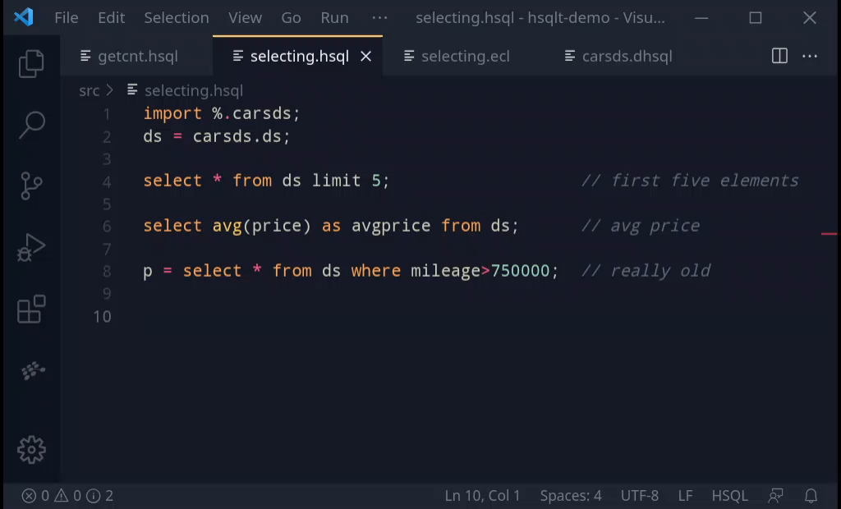
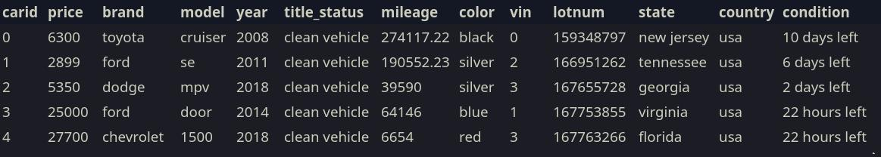

SELECT
Using a familiar language (SQL) for powerful analytics
Simple Queries
Filtering, Ordering & Distributing
Aggregations
Joins
Notes:
So, now we can talk about some of the language features in HSQL.
We had seen the select statement just now, and the select statement is the most important part of HSQL.
Its purpose is to be able to process and work with tables, similar to SQL.
It can be used directly as I’ve shown, or assigned to a definition for further re-use
Here I write out two SQL statements, which show some basic information on the dataset we’re using.
The first one shows the first five entries of the dataset we’re working with, and the second one shows the average price of the cars in our dataset.
The third statement, which is stored in a definition, can be reused, and here <click for anim>, the table can be written to a logical file for later use.
<click for anim> The results show 5 such cars, and we get an average price for the cars in the dataset.
2 second pause

Slide 15
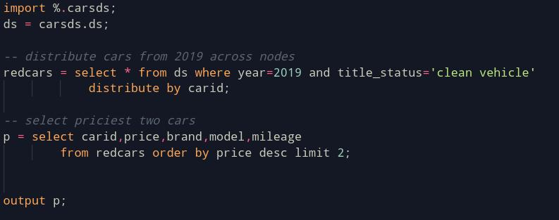
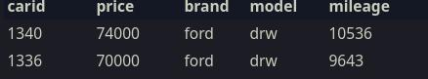
SELECT
Using a familiar language (SQL) for powerful analytics
Simple Queries
Filtering, Ordering & Distributing
Aggregations
Joins
Notes:
HSQL, can be used to perform complex filters, and another new feature is the distribute by; it helps even data skew, by distributing the data across the nodes in your cluster.
Here we pick the two most expensive cars, <click for anim> that are from 2019 and clean.
2 second pause

Slide 16
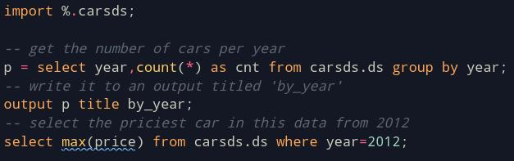
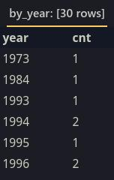

SELECT
Using a familiar language (SQL) for powerful analytics
Simple Queries
Filtering, Ordering & Distributing
Aggregations
Joins
Notes:
We can also have aggregations, and here are some examples.
The first example, is on an aggregation, combined with a GROUP BY. This yields a by-year-count of the cars present in the dataset.
We can then print it out, also giving it a nice title. <click for anim>
Additionally, we can run a simple aggregation, where we get the price of the most expensive car in 2012 in this dataset.
2 second pause

Slide 17
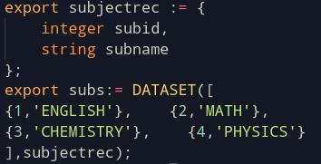
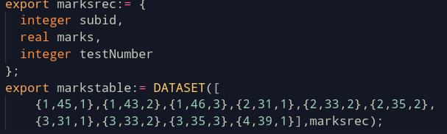
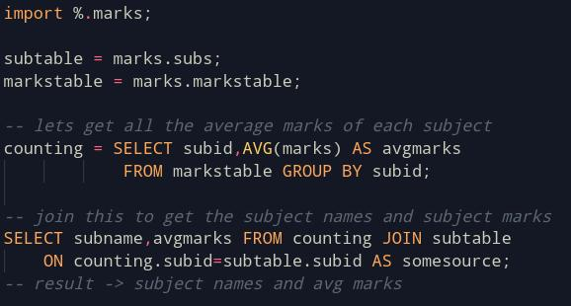
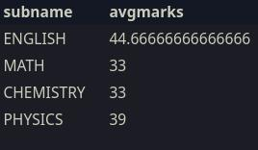
SELECT
Using a familiar language (SQL) for powerful analytics
Simple Queries
Filtering, Ordering & Distributing
Aggregations
Joins
marks.ecl
HSQL
Output
Notes:
And for joins, we can actually look at another feature, which is the fact that HSQL is intended to work seamlessly with ECL.
On the ECL program marks.ecl, we have created and exported two small tables The first table, subs is a mapping between subject id and its name
In the other table, we have a set of marks scored in tests by a person in those subjects.
<click for anim>
We can work with this exported data by simply importing it. Now, to see the average marks per subject, we can use a select statement to do a group by and an aggregation which gets us the subject id and the avg marks scored in each subject.
Now, to get the a better readable output, we can join the subject table and the marks table, (specifically an inner join), and get a nice output that shows the subject name, and the avg marks scored in that subject. <click for anim>
2 second pause

Slide 18
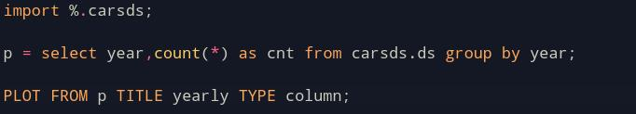
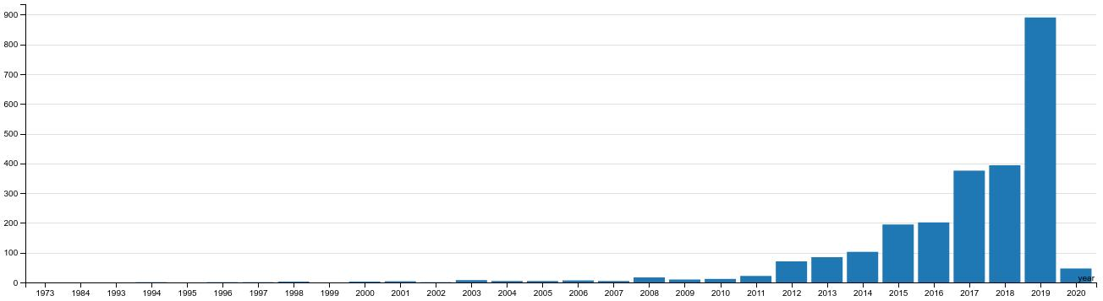
Visualizations
Plotting useful visualizations
Notes:
Visualizations are another important part of HSQL.
Viewing tables are good, but seeing plots and charts make it more easier to work with data.
Previously, we made a table that represents the by-year count of cars in our dataset that we were working with, and we can actually visualize this table as a column chart using the plot statement. <click for anim>
Interestingly, most of these cars are from 2019, but we see some are from as far back as 1973.
2 second pause

Slide 19
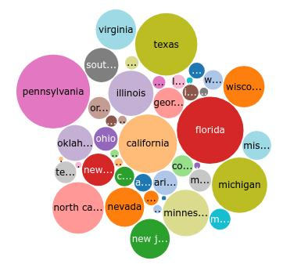
Visualizations
Support for most plotting types from the Visualizer Framework
Bubble
Pie
Wordcloud
Area
Bar
Column
Line
Scatter
Step
Count of cars per state - Bubble
Notes:
Currently, we support most of the standard plotting methods from the visualizer bundle and on the right, is another example; a per-state count of the cars as a bubble plot.
We see that a lot of the cars in this dataset are from Pennsylvania, Florida, and so on
Going ahead we also can talk about a few of the newer features in HSQL.
2 second pause

Slide 20
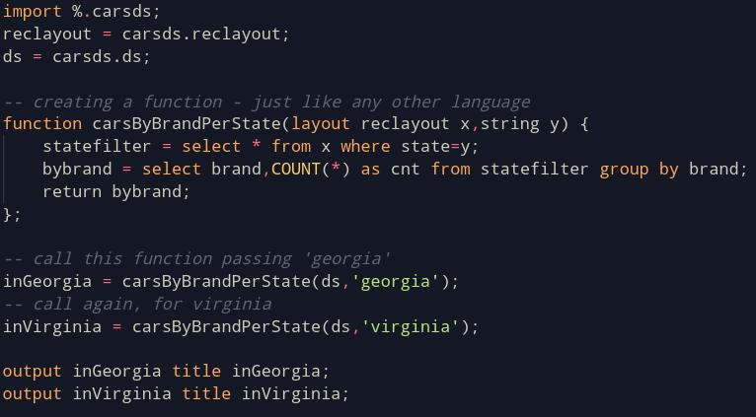
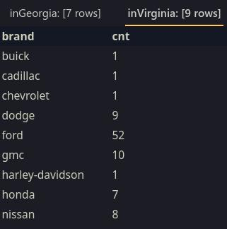
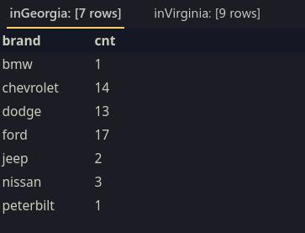
Functions
Writing reusable code
Notes:
Functions, help us in writing reusable code. In this example function here, <carsbybrandperstate>, gives a per-brand count of the cars in a given state. This is done by using two simple select statements that do the filtering and aggregation, followed by returning the result.
This function can be called by passing the appropriate arguments, which are the dataset and the respective state, and we get back some nice results. <click for anim>
We see that the dataset has a lot of cars in virginia that are from ford, gmc and dodge,
& in Georgia; there are many cars from ford, Chevrolet and dodge.
2 second pause

Slide 21
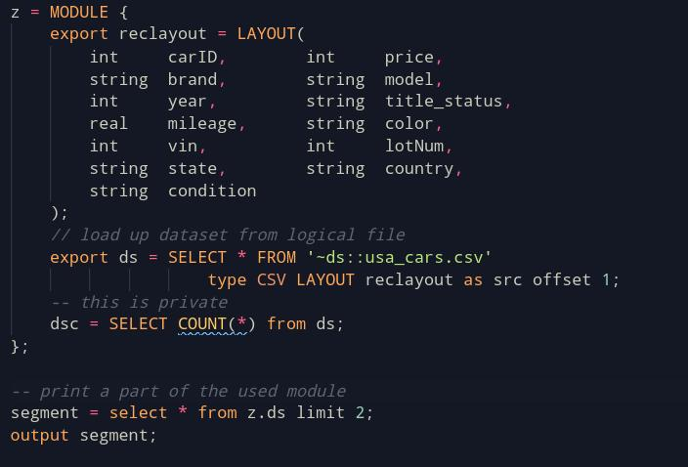
Modules
Structuring Code
Notes:
Another feature, Modules can help us in structuring our code.
Here, we wrap a record layout and a dataset and we an take from a logical file, into a module.
Using this module is very simple, and its with the standard dot notation you can access all its exported members.
As an example , we have a simple output query that takes the first two rows of the dataset from the module and the next statement prints it out.
<click for anim>
And here, we can see the first two rows of the dataset as an output
2 second pause

Slide 22
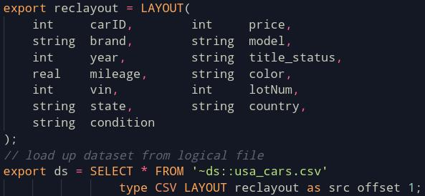
Exporting
Export data for other files for use
Notes:
We can also export definitions from our file, which allows us to use it in other ECL and HSQL files.
This program here, exports the record layout and the dataset used in the programs for the cars dataset, which have been using so far.
2 second pause

Slide 23
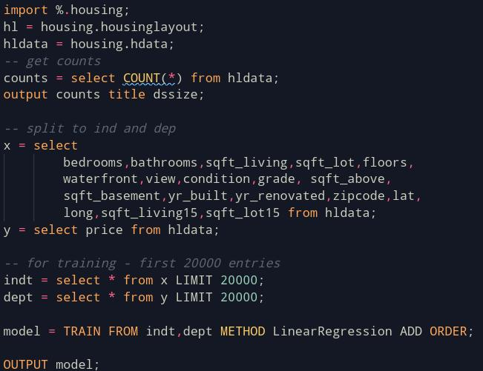
Machine Learning
Creating and using simple Machine Learning Models
Create models
Run predictions
Notes:
We can now move on to Machine Learning, which is another really important part of HSQL. The idea is to be able to easily create and use simple Machine Learning Models. This, is done by the train and predict statements.
For this example, we will take a simple house pricing dataset, where we can filter out the independent and dependent variables.
From here, we can pick out some entries for making a training set, and create a simple model using the train statement.
Here, we just print out the model.
2 second pause

Slide 24
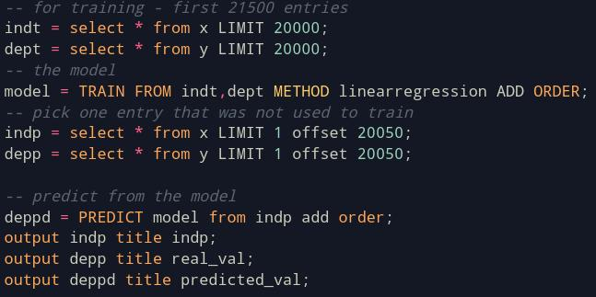

Machine Learning
Creating and using simple Machine Learning Models
Create models
Run predictions
Notes:
But that’s not the main point of creating a model. Instead, we can pick up elements which weren’t in the training set, and we can use it for running predictions against the model.
Using the model we created before, we can predict the price expected for the independent variables supplied, using the predict statement.
<click for anim>
So on the left is the real value, and on the right is the predicted value.
These two statements, TRAIN and PREDICT help wrap up the statements usually required for machine learning, into easy and simple to use statements.
2 second pause

Slide 25
Using HSQL
HSQL in HPCC Systems
Analyze Data
ML Models
Visualize
Explore Data
Work with Data seamlessly
Create simple models
Run predictions
Create visualizations
Get an idea of how the data looks like
Notes:
So, in summary, HSQL should help in
Analyze and work with data, …
Use and create simple machine learning models, …
Create visualizations to help understand your data better
2 second pause

Slide 26
Customer Env:
https://github.com/hpcc-systems/HSQL.git
OPEN
SOURCE
Contact Us
Mahdi Kashani
Mahdi.Kashani@lexisnexisrisk.com
Notes:
Thank you for your time.
To check our product please you can visit our HSQL github repository, and also, we’re open to feedback and for further information and inquiries you can contact us over email.
2 second pause or more ☺

